Slide 1

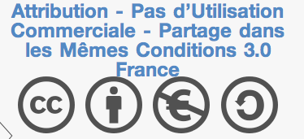
CLUSIR InfoNord
18 Décembre 2014 Lille
OWASP IoT Top10, the life and the universe
Sébastien Gioria
Sebastien.Gioria@owasp.org
Chapter Leader & Evangelist OWASP France

Slide 2



http://www.google.fr/#q=sebastien gioria
Innovation and Technology @Advens && Application Security Expert
OWASP France Leader & Founder & Evangelist,
OWASP ISO Project & OWASP SonarQube Project Leader
Application Security group leader for the CLUSIF
Proud father of youngs kids trying to hack my digital life.
Twitter :@SPoint/@OWASP_France
2
2

Slide 3
Agenda
OWASP ?
Why Internet of Things and OWASP
IoT Risks and vulnerabilities for CISO
OWASP IoT Top10

Slide 4
Open Web Application Security Project
OWASP Moto : “Making Application Security Visible”
Born in 2001; when Web explode. “W” of Name is actually a big cannonball for us
An American Fondation (under 501(c)3 ) => in France a 1901 association
Cited in a lot of standards :
PCI-DSS
NIST
ANSSI guides,
....
OWASP is everywhere : Tools, API, Documentation, Conferences, blog, youtube, podcast, ....

Slide 5

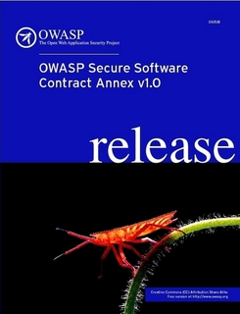
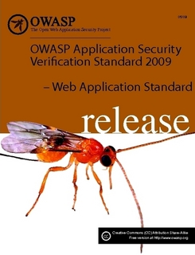
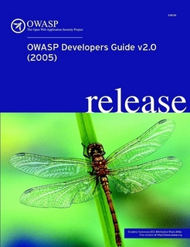




Learn
Contract
Design
Code
Testing
Maturity

Slide 6
OWASP publications !
Lot of Publications :
Top10 Application Security Risk ; bestseller
Testing Guide ; second bestseller
OWASP Cheat Sheets !!!
Application Security Verification Standard ; not the best well known document
OpenSAMM : improve your application security
OWASP Secure Contract Annex
OWASP Top10 for ... (mobile, cloud, privacy, ...)
and many more....

Slide 7
OWASP Tools and API
Lot of Tools / API
OWASP Zed Attack Proxy ; replace WebScarab with a lot of new functionalities
OWASP ESAPI : API for securing your Software
OWASP AppSensor ; a IDS/IPS in the heart of your software
OWASP Cornucoppia ; application security play with cards
OWASP Snake and ladder : play Top10
and many more....

Slide 8
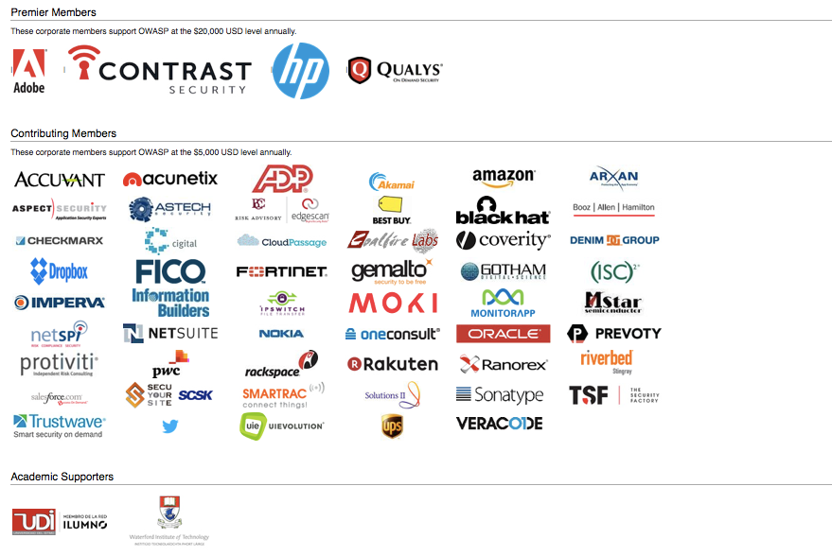
Thank you !

Slide 9
Why OWASP and IoT ?
OWASP mission is to secure Application
OWASP publications are note limited to Web : Top10 Mobile, Top10 Cloud, Top10 Privacy
IoT are actually under fire, so naturally OWASP need to help IoT developers and other guys

Slide 10

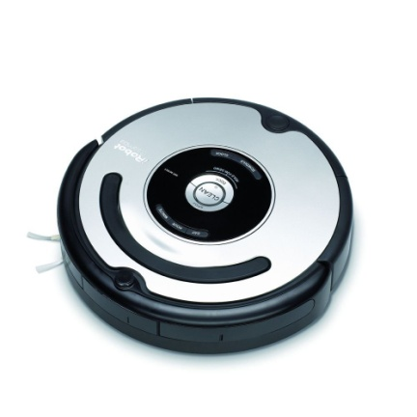
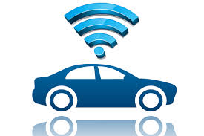
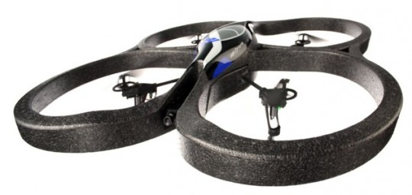
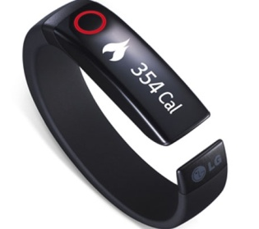
IoT a revolution ? or an evolution ?
If you ask Tim Cook :
This is a revolution !
If you really look in depth, IoT are commons in our life ;
Vacuum cleaners Robots
Cars,
Drones,
“Personal health” wristlet and watch
TV, Home Security Systems, ....
This is not always the best response. Everybody know the best response is 42 !

Slide 11
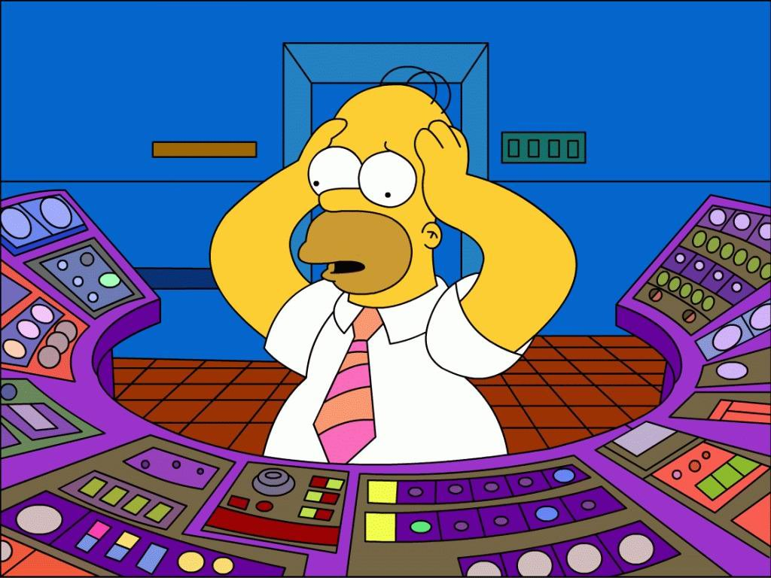
IoT Impact in entreprises
More and more assets
More assets not “known” and not “secure”.
More Legal problems
and more leakage....

Slide 12
OWASP IoT Top10 2014
A1: Insecure Web Interface
A2: Insufficient Authentication/Autorization
A3: Insecure Network Services
A4:Lack of Transport Encryption
A5: Privacy Concern
A6 : Insecure Cloud Interface
A7: Insecure Mobile Interface
A8: Insecure Security Configurability
A9: Insecure Software / Firmware
A10: Poor Physical Security

Slide 13
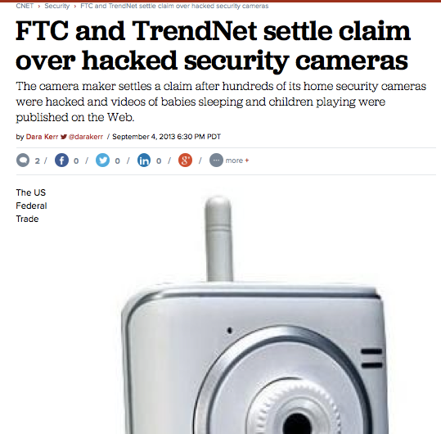
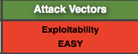
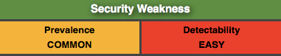
A1: Insecure Web Interface
Risk :
Access from anywhere to the object
Solution :
Pen / testing the Web Interface
Redesigning the product
Tools :
OWASP Testing Guide v4.0
OWASP Zap Proxy

Slide 14
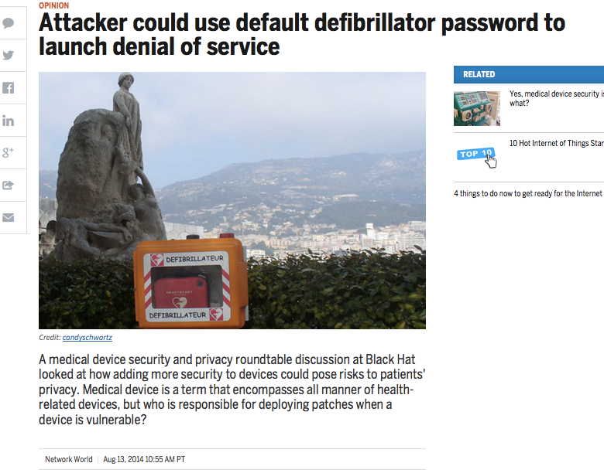
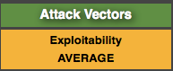
A2: Insufficient Authentication / Autorization
Risk :
Access from anywhere to the object
Leak of Data
Solution :
Sniffing the Network
Manuel Testing
Reviewing the password policy
Tools :
OWASP Testing Guide v4.0
OWASP Zap Proxy

Slide 15
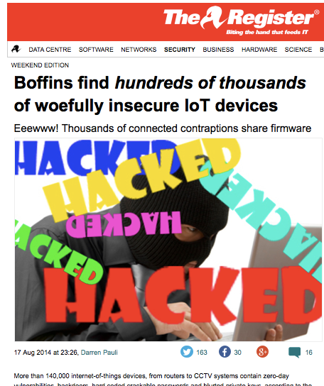
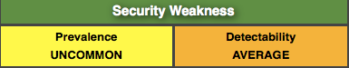
A3: Insecure Network Services
Risk :
Data Loss
Denial of Service
Solution :
Manual PenTesting
Fuzzing
Network scanner
Tools :
OWASP Testing Guide v4.0
OWASP Zap Proxy
Nmap / Nessus
Notes:
More than 140,000 internet-of-things devices, from routers to CCTV systems contain zero-day vulnerabilities, backdoors, hard coded crackable passwords and blurted private keys, according to the first large scale analysis of firmware in embedded devices.
Four researchers from EURECOM France found the flaws when conducting a simple but systematic, automated, and large-scale analysis of 32,356 firmware images running on embedded systems within thousands of different devices.

Slide 16
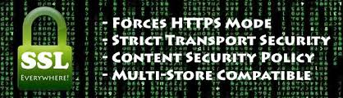
A4:Lack of Transport Encryption
Risk :
Leak of Data
Solution :
Sniffing the Network
Manuel Testing
Tools :
OWASP Testing Guide v4.0
OWASP Zap Proxy
SSLScan

Slide 17
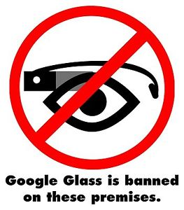
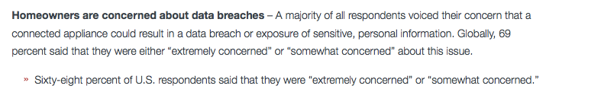
A5: Privacy Concern
Risk :
Leak of Data
Solution :
Manual Testing
Review of the data collected
Tools :
OWASP Testing Guide v4.0
OWASP Zap Proxy

Slide 18
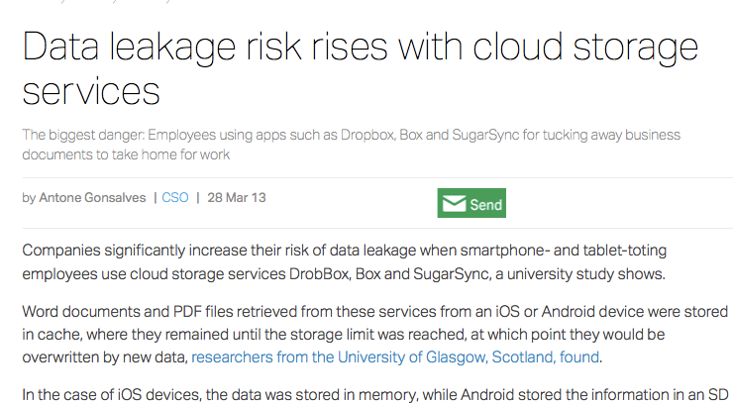
A6 : Insecure Cloud Interface
Risk :
Leak of Data
Solution :
Manual Testing
Review of the data collected
Tools :
OWASP Testing Guide v4.0
OWASP Zap Proxy

Slide 19
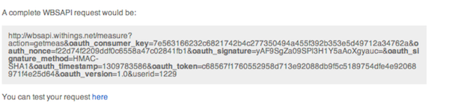
A7: Insecure Mobile Interface
Risk :
Leak of Data
Solution :
Manual Testing
Sniffing the network
Review of the collected data
Tools :
OWASP Testing Guide v4.0
OWASP Zap Proxy

Slide 20
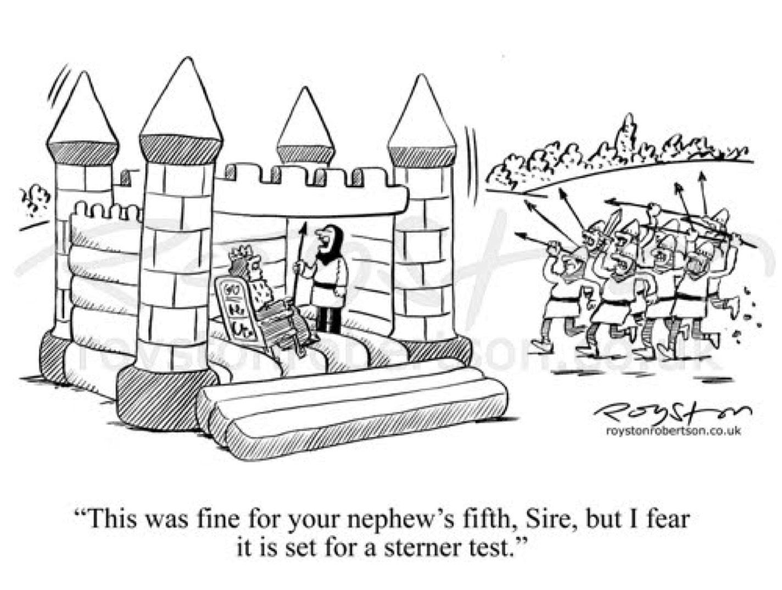
A8: Insecure Security Configurability
Risk :
Leak of Data
Access to the object
Solution :
Manual Testing
Review of configuration/documentation
Tools :
OWASP Testing Guide v4.0
OWASP Zap Proxy
Notes:
When OWASP talks about “security configurability” it is really talking about security features such as password policy enforcement, data encryption, and different levels of access. The good news is that most corporate environments now have an established security policy that tell you exactly what security controls your hardware and software need to have to be safely deployed in your environment. You probably also have the advantage of performing this type of analysis on dozens of things in your existing environment, usually from a remote interface.
If there is one additional aspect you need to be aware of when evaluating smart IoT devices is that they are often based on traditional operating systems such as Microsoft Windows or Linux which themselves have multiple levels of user access, including full administrator or root permissions. Known “privilege escalation” attacks against these operating systems should be attempted if they are ever found on a target device.

Slide 21
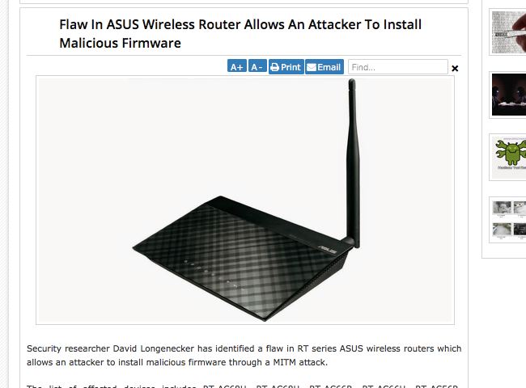
A9: Insecure Software / Firmware
Risk :
Leak of Data
Controling the object/network
Solution :
Manual Testing
Binary Analysis
Sniffing the network
Tools :
OWASP Testing Guide v4.0
OWASP Zap Proxy
Notes:
To test whether or not a device is using insecure updates, you generally need to use a proxy or sniffer to watch the data stream for use of secure transport. To examine the update itself, you can often use an attack proxy to divert the download or a simple URL (or utility) to download it to a desktop location for further inspection. For example, an online utility called “APK Downloader” lets you download and inspect Android installations and updates on any platform.

Slide 22
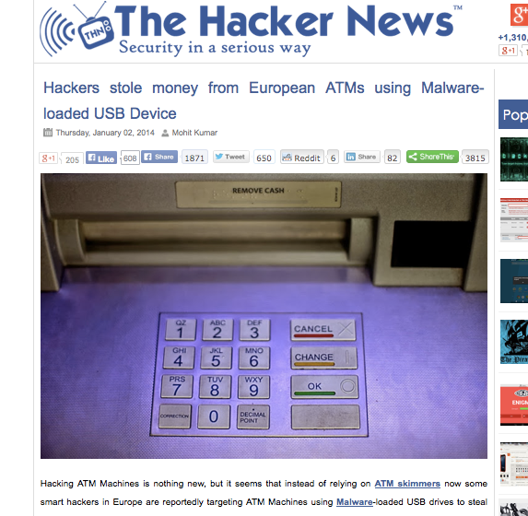
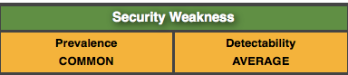
A10: Poor Physical Security
Risk :
Compromising the data and the object itself
Solution :
Manual Testing
Insert USB/SD ....
Tools :
USB malware

Slide 23

Dates
OWASP AppSec California 2015
26/29 January 2015 – Santa Monica
OWASP London Cyber Security Week
26 / 30 January 2015 – London
OWASP AppSec Europe 2015 :
Amsterdam : 19/22 May 2015

Slide 24

Soutenir l’OWASP
Différentes solutions :
Membre Individuel : 50 $
Membre Entreprise : 5000 $
Donation Libre
Soutenir uniquement le chapitre France :
Single Meeting supporter
Nous offrir une salle de meeting !
Participer par un talk ou autre !
Donation simple
Local Chapter supporter :
500 $ à 2000 $

Slide 25
License
@SPoint
sebastien.gioria@owasp.org

